Slide 1
Software project lab – I
Project Title: A Digital Watch

Slide 2
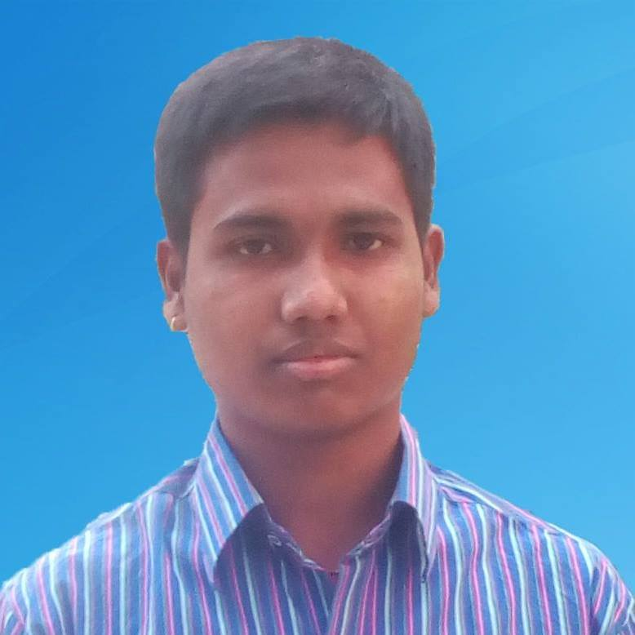
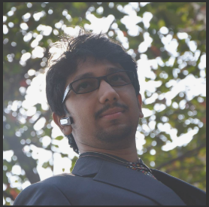
Presented by Tulshi Chandra Das Roll: BSSE 0811
Supervised by Amit Seal Amit Lecturer ,IIT DU

Slide 3
Outline
Introduction
Description
Motivation
Objectives
Dependencies
Timeline
Question & Answer

Slide 4
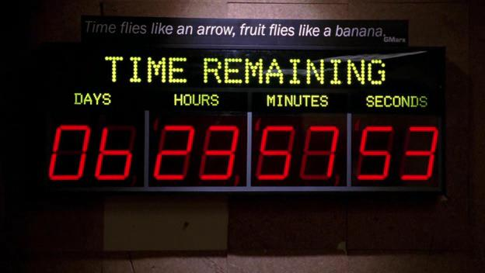
Introduction
Time is part and parcel of life
Therefore time management is essential to everyone
Therefore a timing device is necessary
A digital watch can play a vital role in this aspect
My project starts with these aspects
image source: https://www.google.com/search?q=images+to+show+i …………..

Slide 5
Description
Project contains
Digital watch that display the current time
Stopwatch
Timer
Best benefit calculator from different weighted work within certain time
Calendar
Interface
Different options / button have to be used to run the components

Slide 6

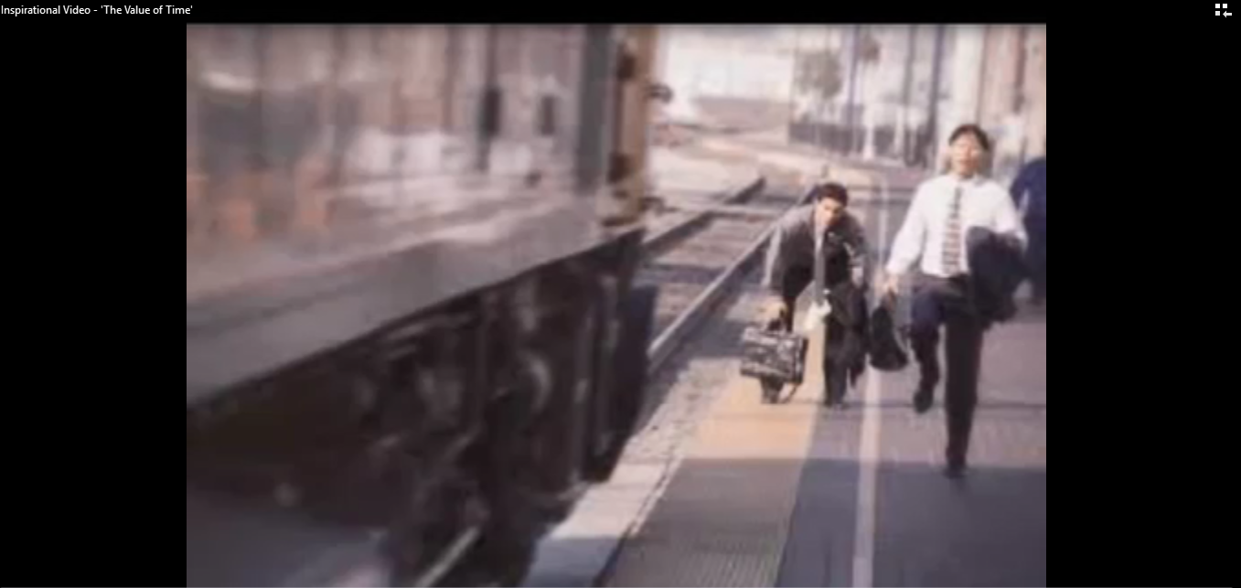
Motivation
Time should be used properly
A good interface of time and date is helpful to make the best use of time
1 sdsd

Slide 7
Objectives
To provide good facilities of time maintenance and display
To estimate efficiency with stopwatch
To estimate the best benefit from different weighted work
To give time boundary facility with timer
To see calendar time

Slide 8

Dependencies
Java Runtime Environment 1.8

Slide 9
Project proposed timeline

Slide 10
?? Q & A

Slide 11
Thank you

